Slide 1
Metagenomics, Day 3, Afternoon: Binning and MAGs
Titus Brown
July 17, 2025
STAMPS 2025

Slide 2
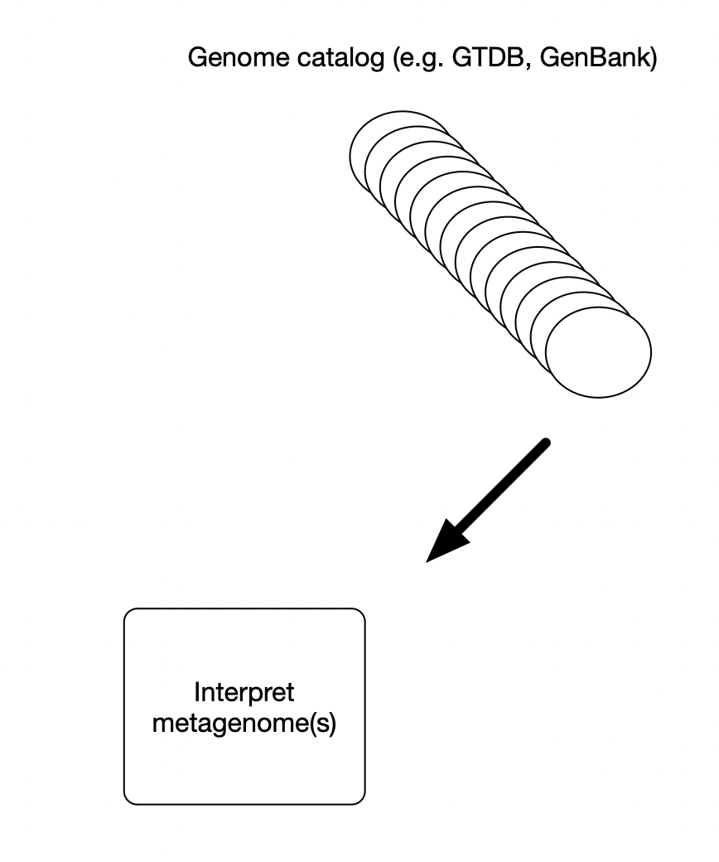
Interpreting metagenomes using a genome catalog is the best way (most sensitive/specific) to interpret metagenome content.
With one big challenge:

Slide 3
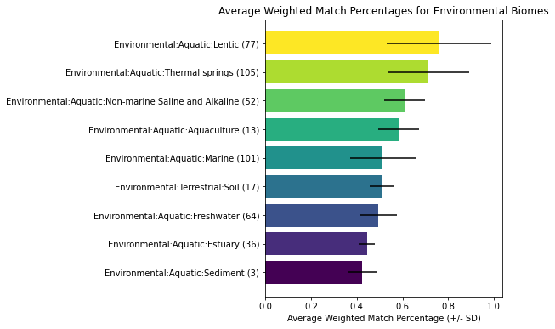
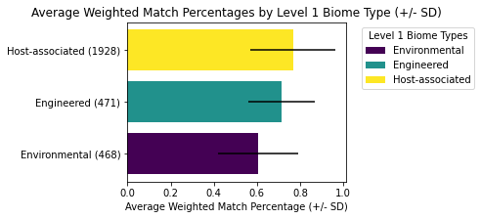
Using ~3000 metagenomes from MGnify
Many types of metagenomes have low explainability/assignability
Fraction of metagenomes that match GTDB rs220 + eukaryotes, by metagenome type
Jean Zhao, UC Davis
Notes:
weighted_vs_biome_plot

Slide 4
Many metagenomes lack relevant reference genomes.
Many microbes are hard to culture in isolation;
Unknown culture conditions and/or cross-feeding
Many microbiomes are poorly explored, and/or highly diverse:
Soil and sediment are particularly notorious!
Single-cell microbial sequencing is powerful but does not yet yield complete genomes;

Slide 5
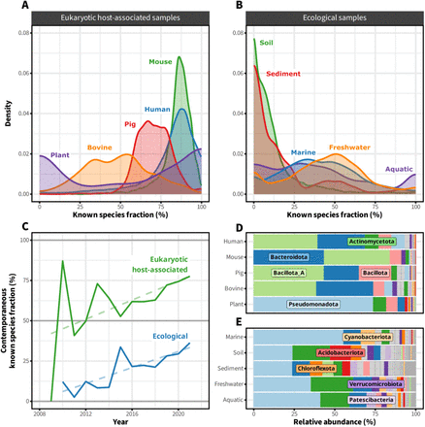
SingleM and Sandpiper: Robust microbial taxonomic profiles from metagenomic data,
Woodcroft et al., 2024, bioRxiv

Slide 6
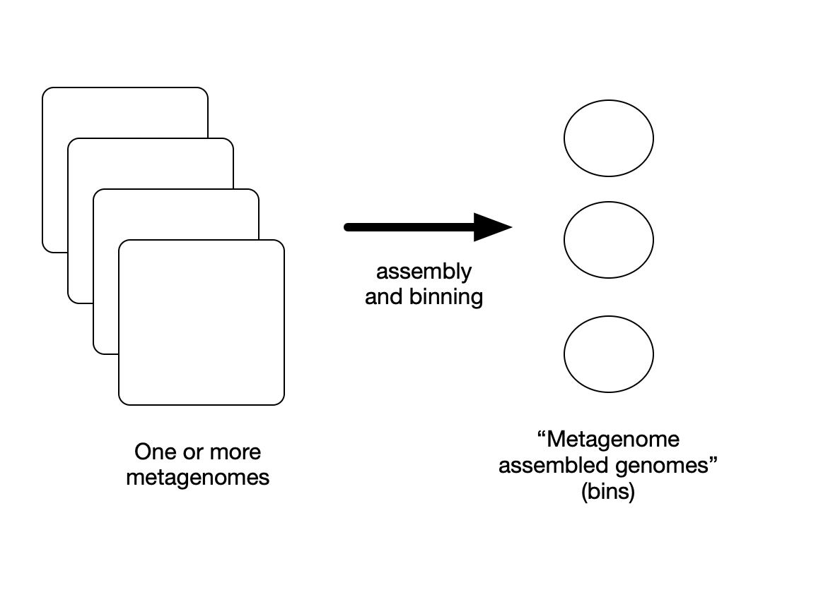
Computationally generate new microbial genomes from metagenomes: “metagenome assembled genomes”, or “genome bins”.

Slide 8
Computationally generate new microbial genomes from metagenomes: “metagenome assembled genomes”, or “genome bins”.

Slide 9
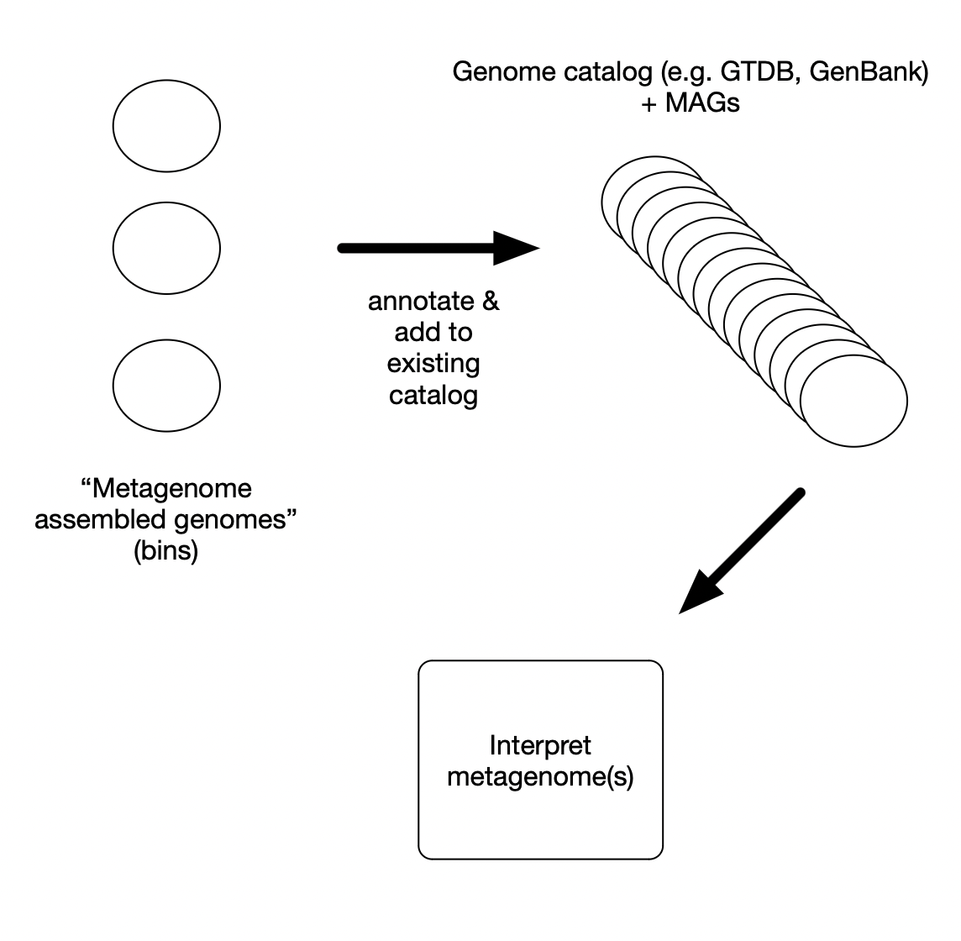
Then, add these new genomes to your catalog of known genomes and use them to interpret your metagenome(s).

Slide 10
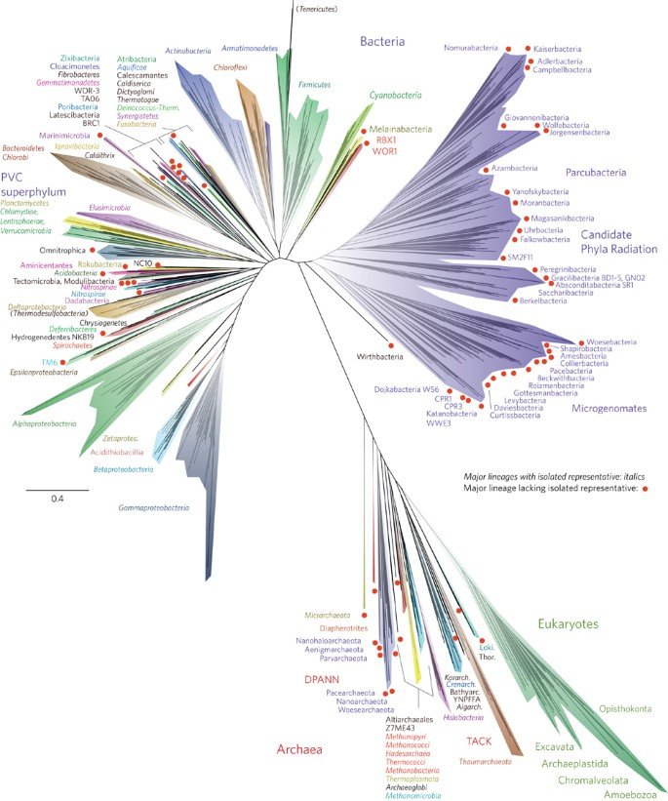
Starting in 2010, the majority of new bacterial and archaeal phyla have been discovered via metagenomics, because they are hard/impossible to culture.
Hug et al., Banfield, 2016.

Slide 11
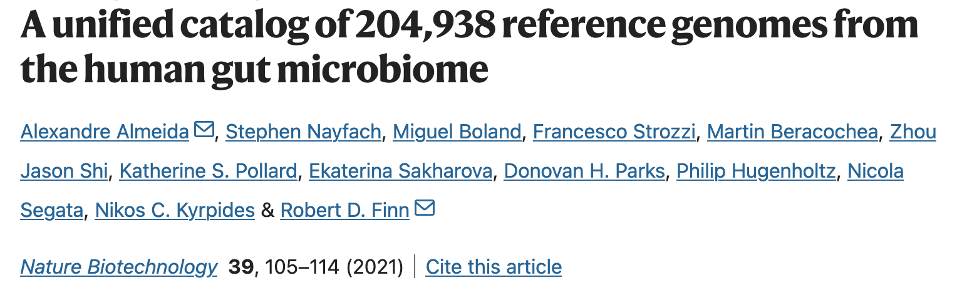
The majority of genomes in GenBank are now MAGs.

Slide 12

Etc. ☺

Slide 13
Questions to discuss:
When is a binning effort useful?
What kinds of sequencing is most appropriate? => long reads
What environments are “hard” to bin? => highly rich & diverse environments, as well as environments with lots of strain diversity.
Todd Treangen will discuss assembly, and binning, and strain diversity, on Friday!

Slide 14
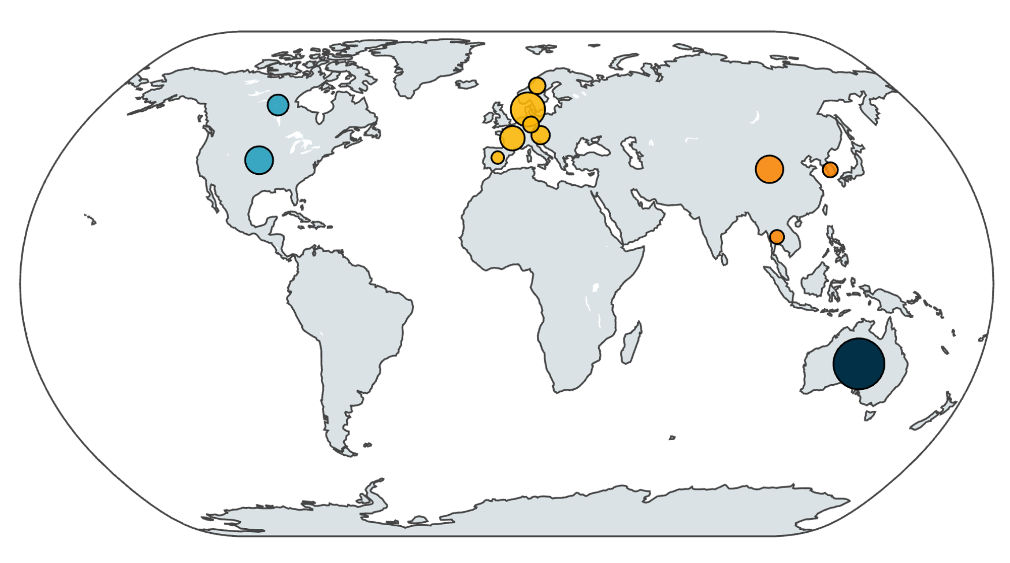
An (emerging) case study: building a genome catalog from pig gut metagenomes

Slide 15
Pig gut metagenomes: worldmap + country pcoa.
Anneliek ter Horst, UC Davis
Figure: Overview of country of origin for all metagenomes used. Bubbles are log-transformed and relative to the number of metagenomes from that country
Notes:
250620_worldmap.svg
underrepresented countries / continents
bubbles are log transformed and relative to number of samples from that country

Slide 16
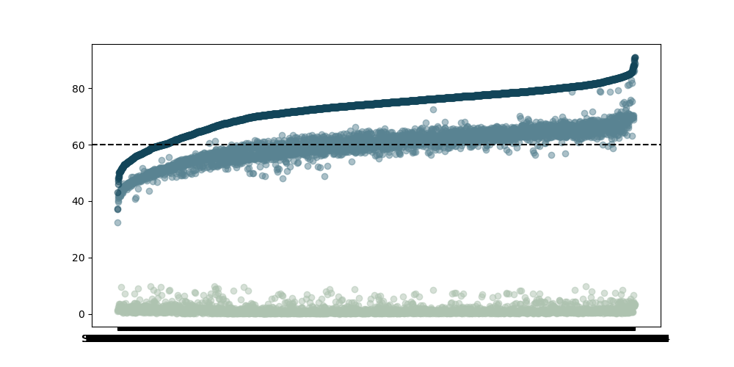
Unknown microbial content decreases when adding host-specific reference genomes by 13% on average
eukaryote content
microbial content
microbial content, if only using GTDB (reference DB)
fraction of data assigned
to known content
280
Anneliek ter Horst, UC Davis
3,217 datasets, rank ordered by fraction of data assigned to microbial genomes

Slide 17
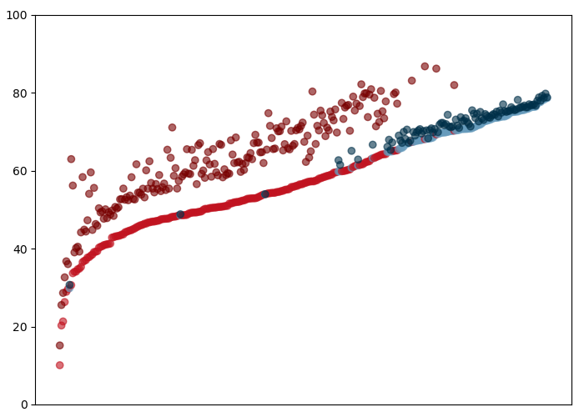
MAG generation increases the amount of data in metagenome that can be assigned to a species
Adding pig specific reference genomes helps assign more data to (now) known microbial genomes.
% of dataset assigned to known microbe
Before and after pig MAG generation, human metagenomes are well explained
After pig MAG generation, ~13% more of pig metagenomes can be matched.
Anneliek ter Horst, UC Davis
300 metagenomes, rank ordered by explainability

Slide 18
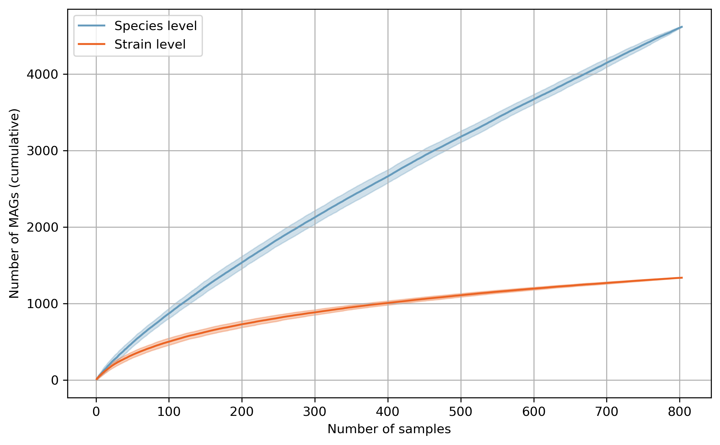
While species level diversity saturates, strain does not
Anneliek ter Horst, UC Davis
How many new species/strains are found in each new sample?
Species level curve suggests sufficient sampling effort
Strain level curve shows no saturation, so more samples will reveal more strain level diversity

Slide 19
Thoughts on the pig gut metagenome effort -
We are seeing substantial new strain-level diversity and some surprising species-level diversity that would have gone unrecognized without this effort.
Seems likely that each new environment will have many new strains and some new species.
We are developing metrics for sourmash to help determine when a MAG-building effort is a potentially good idea (as well as to figure out when you’re “done” ☺)

Slide 20
Perhaps the most important thing to know about MAG generation and genome binning:
Assembly and binning has reasonably high precision, but very poor recall.
OR, to put it another way, most genomes present in a metagenome will not assemble+bin.
This can be for many technical reasons; ask Todd for details on Friday ☺
HOWEVER, bins generated from a particular metagenome can help you interpret other metagenomes from that environment.

Slide 21
Perhaps the most important thing to know about MAG generation and genome binning:
When exploring a new environment, apply assembly and binning to all your metagenomes.
Build an “environment specific” catalog…
…and then combine that with your other catalog(s), and use the combined catalog to interpret your metagenomes.
Do not assemble and bin a metagenome, and then characterize the bins, and then claim that you’ve characterized the entire metagenome. ☺

